Slide 1
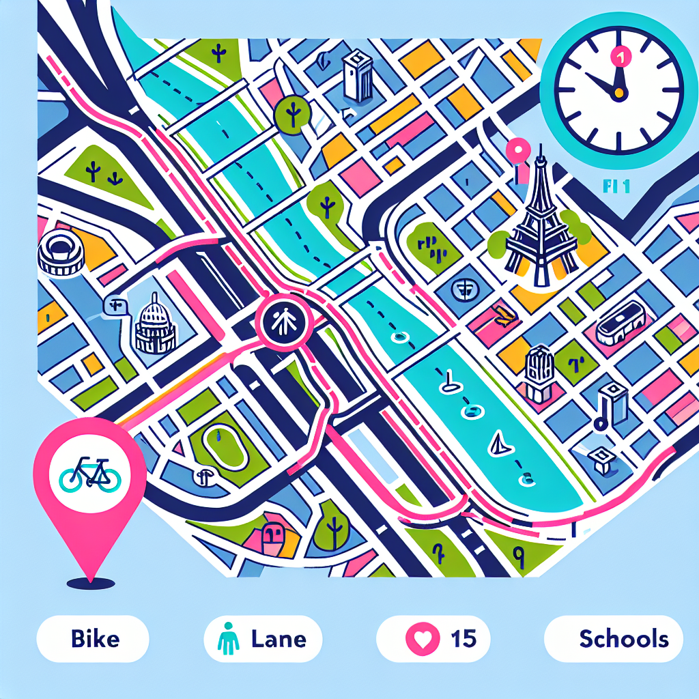
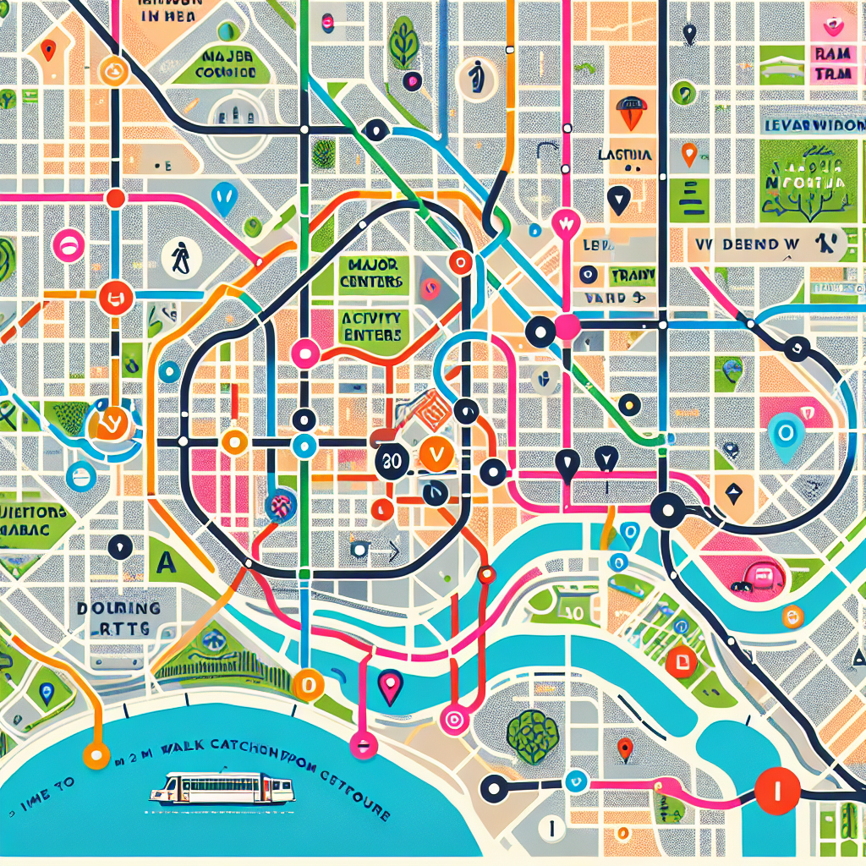
Case Studies: Paris & Melbourne
Paris Approach: Citywide proximity strategy—school street closures, bike network expansion, local services, and 30 km/h default on most streets.
Melbourne Approach: ‘20‑minute neighborhoods’ within Plan Melbourne (walkable catchments to daily needs).
‘Rues aux écoles’ (car‑lite school streets)
Neighborhood‑scale amenities and micro‑hubs
Protected cycleways connecting arrondissements
Activity centers as anchors
Green links/laneways network
Health and aging‑in‑place focus
Pair quick‑build trials with permanent upgrades; communicate benefits at the block level.
Use activity center hierarchy to stage investment; align with health outcomes.
Programs evolve; shown features are illustrative.

